Slide 1
al-Farabi Kazakh National University Theory of Education (nurturing, upbringing) of Higher School Lecture14
Senior lecturer of the department of pedagogy
and educational management Zh. Makhambetova

Slide 2
Plan
1.The essence and properties of education.
2.Factors of socialization of the person
3.Criteria of education from ancient times
4.Directions of modern education
5.The formation of a communication culture
6.Physical education and the formation of a healthy lifestyle
7.Professional and creative education

Slide 3
1. The essence and properties of education. Factors of socialization of the person
The concept of "nurturing" comes from the word nutrition. Initially, it was understood as direct nutrition, feeding by the mother of her child. Then, with the development of society, it began to be interpreted as the spiritual upbringing, nurturing of the child.
The ideals of upbringing in different centuries were different. In the Middle Ages, "knightly upbringing" is the mastery of "seven knight virtues", the ability to ride a horse, swim, throw a spear, to fencing, hunt, play drafts, compose and sing songs in honor of suzerain and "ladies of the heart." In the era of revival- the education of a citizen. "Civic Education" implied the formation of a member of a society with good manners, alien Christian asceticism, developed bodily and spiritually, brought up in the course of working life.

Slide 4
In English society,
the ideal of John Lock was the education of a gentleman. Its content included: reading, writing, drawing, native language, French and Latin languages, geography, astronomy, chronology, ethics, dancing, fencing, social behavior skills - "good manners and knowledge of the world".
The ideal of communist education of the early twentieth century was the image of a "communist fighter". In bourgeois society, the image of a "successful bourgeois". In modern society, an ideal can be considered a successful businessman. Thus, each epoch had its own ideal of education.

Slide 5
Criteria of education from ancient times were the criteria of Goodness, Truth, Beauty:
-"goodness" as behavior for the benefit of another person (people, society); -"Truth" as a guide in assessing actions and actions; -"beauty" in all forms of its manifestation and creation (in particular, the creation of beauty in the profession, patronage, etc.)
The ideal goal of education is the formation of a harmoniously (comprehensively) developed personality, the education of a competent specialist. The content of education (nurturing) is moral, civic, intellectual, physical, labor (professional), aesthetic education.

Slide 6
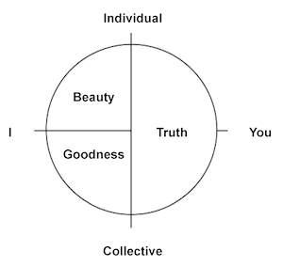
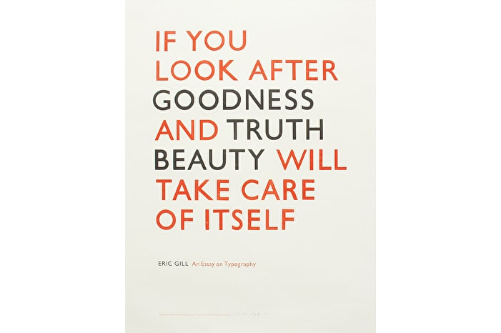
Goodness, Truth, Beauty:

Slide 7
The properties of nurturing process are
purposefulness, multifactorities, duration (remoteness of the goal), continuity, complexity (unity of purpose, objectives, content, forms and methods of upbringing, and the formation of qualities in the complex). Elements of the educational system of the university are: activities, communication, cognition, pedagogical microclimate, the microclimate of the student group.
Factors of socialization of the person are divided into internal and external. Internal is a person's heredity, self-education, etc., external are divided into microfactors (peer group, friends, family, etc.), macrofactors (state, society, country); megafactors (space, planet, solar system, etc.).

Slide 8
2. Directions of modern education
Kazakhstan as a new independent state also has an educational and upbringing ideal. As President N.Nazarbayev noted, "During the years of independence, the basic values ​​of the Kazakhstani path-Freedom, Unity, Stability, Prosperity were formed" (Message of the President of the Republic of Kazakhstan to the people of Kazakhstan "Let's build the future together!" 2011). Therefore, the process of education should translate these basic values ​​of the Kazakh people. Let's consider the directions of education "The concept of upbringing in the system of continuous education of the Republic of Kazakhstan" (Order of the Ministry of Education and Science of the Republic of Kazakhstan No. 521 of November 16, 2009)

Slide 9
Civil-patriotic, legal and multicultural education
should form a civic position and patriotic consciousness, legal and political culture, developed national identity, a culture of interethnic relations, social and religious tolerance based on humanism, love and respect for the language, history and customs of the Kazakh people , maintenance and development of its best traditions, study, acceptance and development of cultures of peoples of Kazakhstan.
Spiritual and moral education presupposes the creation of conditions for the development of self-consciousness, the formation of ethical principles of the individual, its moral qualities and attitudes consistent with the norms and traditions of society, the formation and development of a system of spiritual and moral knowledge and values.

Slide 10
The formation of a communication culture
determines the principles of behavior, reflects the value system, ideals, norms and helps the organization of communication, establishing contacts, and developing them.
• Ecological education presupposes the development and formation of ethical views on the nature and ethics of the attitude towards it, the education of a sense of personal responsibility for the state of natural resources and the reasonable interaction of people with them.
• Aesthetic education presupposes the formation of moral and spiritual values through familiarization with the beautiful, through artistic culture, through accession to the world art values of epochs and peoples, through the prism of the national and universal.

Slide 11
Physical education and the formation of a healthy lifestyle
aims to build a healthy lifestyle, the formation of personal qualities that provide a young person with mental stability and necessary for effective professional activities. • Labor and economic education presupposes the development of skills and habits in children, teenagers and youth in self-service, conscientious, responsible and creative attitude to different types of work; the formation among young people of the need for work as the first vital necessity, the highest value and the main way to achieve life success.

Slide 12
Professional and creative education involves
the formation of professionally and personally important key competencies (special, profile, communicative, social, intellectual, information, personal)
• The development of intellectual culture implies the formation of a modern scientific worldview and the assimilation of basic values, the development of active thinking activities of students.

Slide 13
Recommended literature
Mynbayeva A.K. Basics of Pedagogy of Higher Education. Educational textbook. – Almaty, 2013. – 190p.
Inez De Florio.Effective Teaching and Successful Learning: Bridging the Gap Between Research and Practice.- Cambridge University Press:2016-400 p.

